Slide 1





HR Data on Employee Details

Slide 2
Introduction
HR (Human Resources) analysis involves studying and evaluating employee data to make informed decisions that improve workforce efficiency and business outcomes. SQL (Structured Query Language) is a powerful tool used to analyze and manage data in HR systems.
Using SQL, HR professionals can:
Access and retrieve data from employee databases.
Identify trends in employee performance, retention, and attendance.
Generate reports to understand hiring needs and workforce demographics.
Analyze data to improve decision-making for recruitment, training, and promotions
EMPLOYEE ONBOARDING PRESENTATION

Slide 3
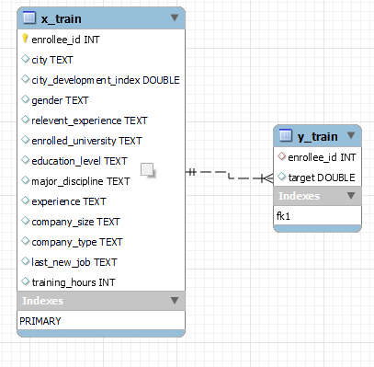
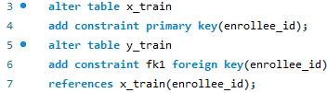
ER Diagram
EMPLOYEE ONBOARDING PRESENTATION

Slide 4

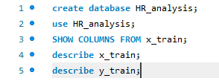

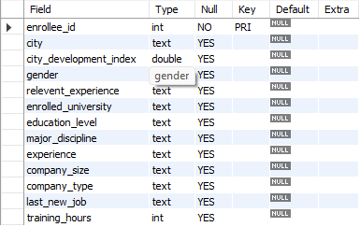

Dataset overview

Slide 5


NUMBER OF EMPLOYEES WHO ACHIEVED TARGET
EMPLOYEE ONBOARDING PRESENTATION

Slide 6




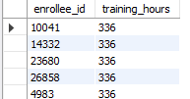
Employees with the most training hours

Slide 7






PROFESSIONALS HOLDING A MASTER'S DEGREE
PROFESSIONALS HOLDING A GRADDUATE DEGREE

Slide 8
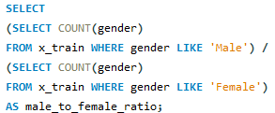





Gender Ratio: Male to Female
EMPLOYEE ONBOARDING PRESENTATION

Slide 9
Thank You

